Slide 1
Pandora’s box
Get the facts about a Constitutional Convention
Pete Savage
Legislative Representative
Legislative and Political Department

Slide 2
New York State Constitution (Article19, § 2), every 20 years the people of the Empire State are asked a seemingly simple ballot question; “Shall there be a convention to revise the constitution and amend the same?”

Slide 3
Will appear on the top of the ballot on November 7, 2017
Will have a huge impact on not only NYSUT members, but every citizen of the state

Slide 4
Constitutional Convention vs.
Constitutional amendments
What’s the difference?

Slide 5
First process
State constitution can be amended in two ways.
Through the passage of individual bills by two separately elected state Legislatures (Article 19, §1).
Bills passed that propose specific amendment questions then appear on the November ballot and need 50% + 1 to pass.
Process was undertaken in 2013 for several changes including:
  Casino Gaming in New York state-Passed
  Sale of specific tracks of land within the constitutionally protected Adirondack Park- Passed
  Increasing the mandatory retirement age for state judges: Failed
This process has been used 200 times since the last major constitutional revision in 1894.

Slide 6
Process was again used last fall for two more proposed changes
Creation of an Independent Commission on Redistricting- Passed
  Changes to election districts based on the 2020 US Census
  New lines will be in place for the 2022 elections
Allow Senate and Assembly to go paperless-Passed
  Constitutional requirement-paper bills must sit on legislators desks for three days
  Would allow bill being “in print” to count toward the three days
  Will save $325,000 a year in paper and printing costs

Slide 7
Second process
Holding a constitutional convention (Article 19, §2)
Question goes before the voters every 20 years
Allows for much wider modifications of the constitution; including a full rewrite

Slide 8
If the voters approve, a multi-year process starts
  Three delegates per- State Senate District and 15 at-large delegates are elected at the next scheduled general election
  These delegates can include sitting members of the State Legislature, political party leaders or other office holders.
  These delegates are allowed to hold both their elected office and a position as a delegate; collecting both salaries
  Convention meets in Albany the following April for an unspecified duration, deliberates and then publishes their suggested amendments
  Proposed changes are then submitted to the votes, either individually or as a group
  Another public referendum vote not sooner than six weeks after the adjournment of the convention.

Slide 9
This process has been used nine times (1777, 1801, 1821, 1846, 1867, 1894, 1915, 1938, 1967) to undertake major re-writes of the state constitution.
Some of these conventions succeeded with votes accepting the suggested changes, while other convention recommendations were rejected by the voters as in 1967.

Slide 10
Why is this so important to me as a nysut member?
What’s at stake?

Slide 11
The constitution establishes a basic organizational structure for state government
If changes are made that give too much power to one branch, for example say the executive, then our system of self-governance will be upended.

Slide 12
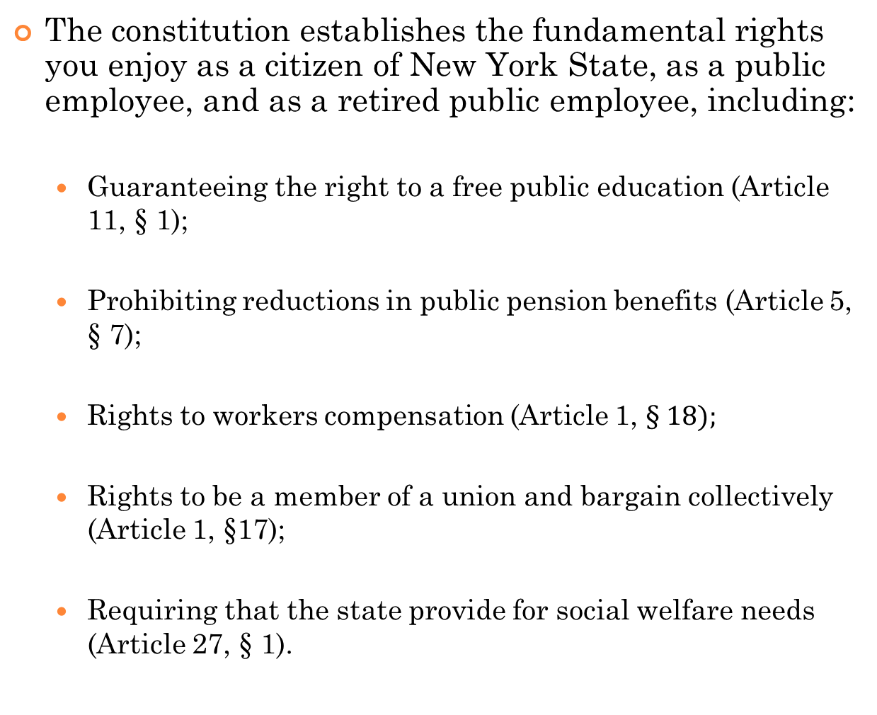

Slide 13
The constitution sets the most important policy goals for the people of New York State
Changes will affect every other law currently in place and on future statutes yet to come.

Slide 14
1967 Convention
Convened by an act of the Legislature a decade after the 20 year scheduled referendum was voted down in 1957
Following the convention, voters rejected the proposed changes
Included proposed repeal to the “Blaine Amendment” which prohibits the use of state monies to be used to assist religious schools
Had this repeal not been rejected by the voters, public education would look very different here in New York

Slide 15
How do I help
& who else will be with us?

Slide 16
Voters rejected the last required call for a constitutional convention in 1997
Rejection was not by accident
Many groups worked together to convince voters that holding a convention was not in the best interest of the people of the state

Slide 17
These groups included:
Public and private organized labor;
Environmentalists and conservationists who did not want to see the repeal of the “forever wild” provisions that protect environmentally sensitive areas;
Advocates for public education at all levels;
Social welfare advocates who will seek to maintain the requirement that New York State provide for the underprivileged
Fiscal conservatives who wanted to keep existing state and debt limits in place; and
Some government watchdog groups who just didn’t want to “spend the millions of dollars to hold a party in Albany!”

Slide 18
Casinos may have helped us in this fight
Passage in 2013 could take their money out of the fight in 2017
-OR-
Put money to fight further expansion of Casino gaming

Slide 19
Will need to work together again in 2017 to make sure voters understand just what could happen if we open up the state constitution to drastic changes through convention
2017 is an “off” election year for the state Legislature as well as an “off” year for presidential voting

Slide 20
2015-2016 Executive Budget Proposal- Governor seeks a Constitutional amendment to strip public officials of their pensions based on 2011 law doing just that
Passes the Senate but does not pass the Assembly…yet.
If passed, could appear below the Constitutional Convention question in 2017 or in 2018 alone
We will need to factor this in going forward

Slide 21
Will need to concentrate our efforts on this important issue
Get involved with your local, stay active with the political process starting today, get informed on the important issues surrounding a constitutional convention and be ready to work come 2017

Slide 22
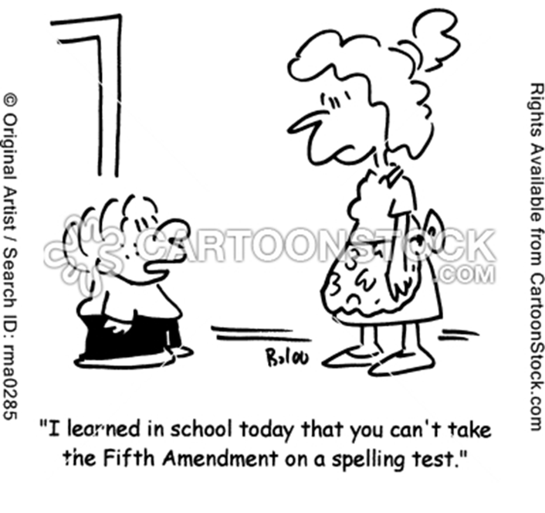
questions

