Slide 1
SUNY Broome Operating Budget Overview
July 2021
Larry Allen, Budget & IE Specialist

Slide 2
Suny broome revenue budget

Slide 3
SuNY broome’s revenue sources
Enrollment
  Tuition
  Chargebacks
  State Aid
  Fees
County Sponsorship
Miscellaneous Revenues

Slide 4
What is the
NYS community college funding philosophy?
equal sharing of costs between…
state, student, and sponsors

Slide 5
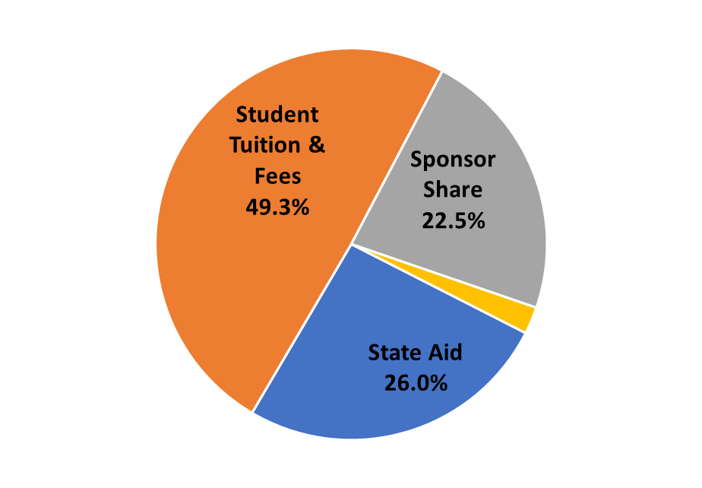
What does SUNY Broome’s funding actually look like?
Students fund more than state or sponsors
state aid 26.0% $14.1 million
sponsors 22.5% $12.2 million
students 49.3% $26.7 million

Slide 6
What is included in “sponsors”?
Broome County $7.4 million
Other NYS counties $4.8 million
Broome County share is referred to as “sponsor contribution”

Slide 7
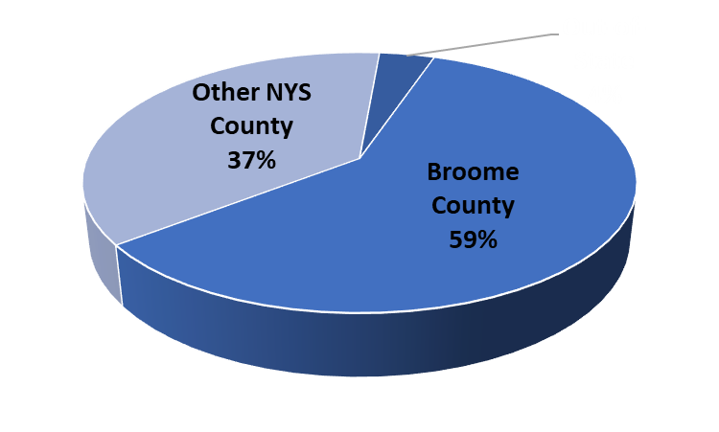
Where are SUNY Brooome students from?
Why does it matter to the budget?
84% of revenues are linked to student enrollment
more revenues per student are received for other NYS county and out-of-state students

Slide 8
What is included in “students”?
Student Tuition $20.0 million
Out-of-State Tuition $1.5 million
Fees $5.2 million

Slide 9
What is the most
New York State can pay?
40% of net operating costs*
*net operating costs = total budget less miscellaneous revenues

Slide 10
What did SUNY Broome’s operating funding look like decades ago?
state paid more…40%
students paid less…32%
Not unique to SUNY Broome – state and national trend

Slide 11
Which revenues are linked to student enrollment?
84% ($45.7 million)
State aid
Tuition and fees
Charges to other NYS counties
Out-of-state tuition

Slide 12
Which revenues are not linked to student enrollment?
Broome County support (sponsor share)
Miscellaneous revenues
(interest, indirect grant revenues, etc)

Slide 13
How much revenue does SUNY Broome receive per student*?
State aid $2,947 / FTE Based on 3-year weighted avg FTEs (50% prior year, 30% 2-years prior, 20% 3-years prior)
Tuition FT $5,088/year >=12 credits per semester
Tuition PT $212/cr hr < 12 credits per semester
Out-of-state tuition double NYS max is triple
Other NYS counties $3,550 SUNY formula
Fees vary by student
*2020-21 State aid, tuition and fee rates

Slide 14
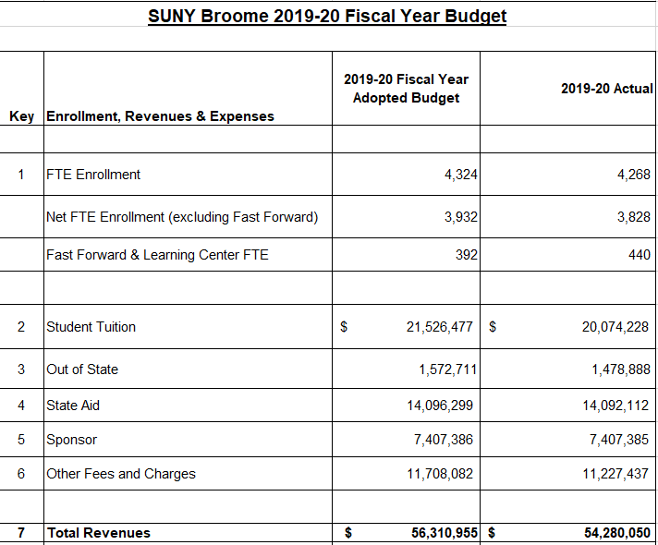
2019-20 Revenue Summary

Slide 15

SUNY Broome expenses
This Photo by Unknown Author is licensed under CC BY-SA

Slide 16
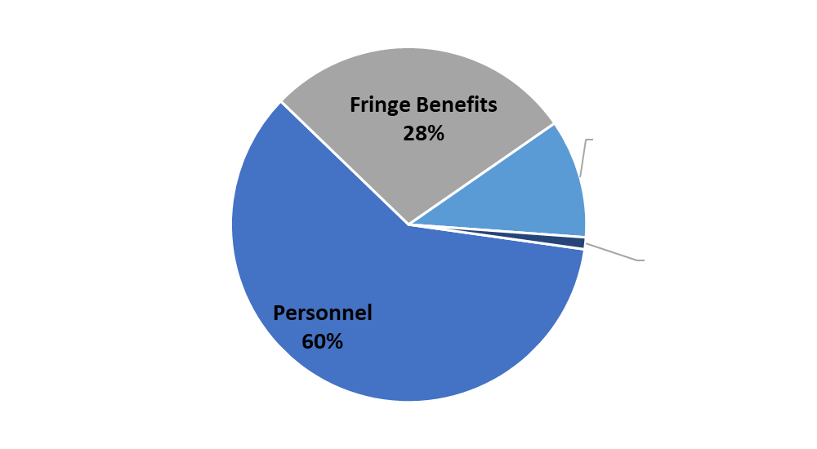
What do SUNY Broome’s expenses look like?
Personnel & Fringe – 88%
Contractual Expenses – 11%
Capital Repairs, Renovations & Equipment – 1%

Slide 17
Personnel Expense

Slide 18
Personnel Expense Summary
Full-time employees represent 78 % of total personnel expenses
Full-time and part-time instructional expenses represent 43 % of total personnel expenses

Slide 19
Contractual/Supply/Travel Expenses
Service Agreements, office supplies, classroom supplies, technology supplies, and staff travel
Typically 10% of the budget is spent on contractual, supplies, and travel

Slide 20
Capital Repairs, Renovations & Equipment
Projects paid through the operating budget that are generally >$5,000
About 1% of total costs are related to capital repairs, renovations, and equipment

Slide 21
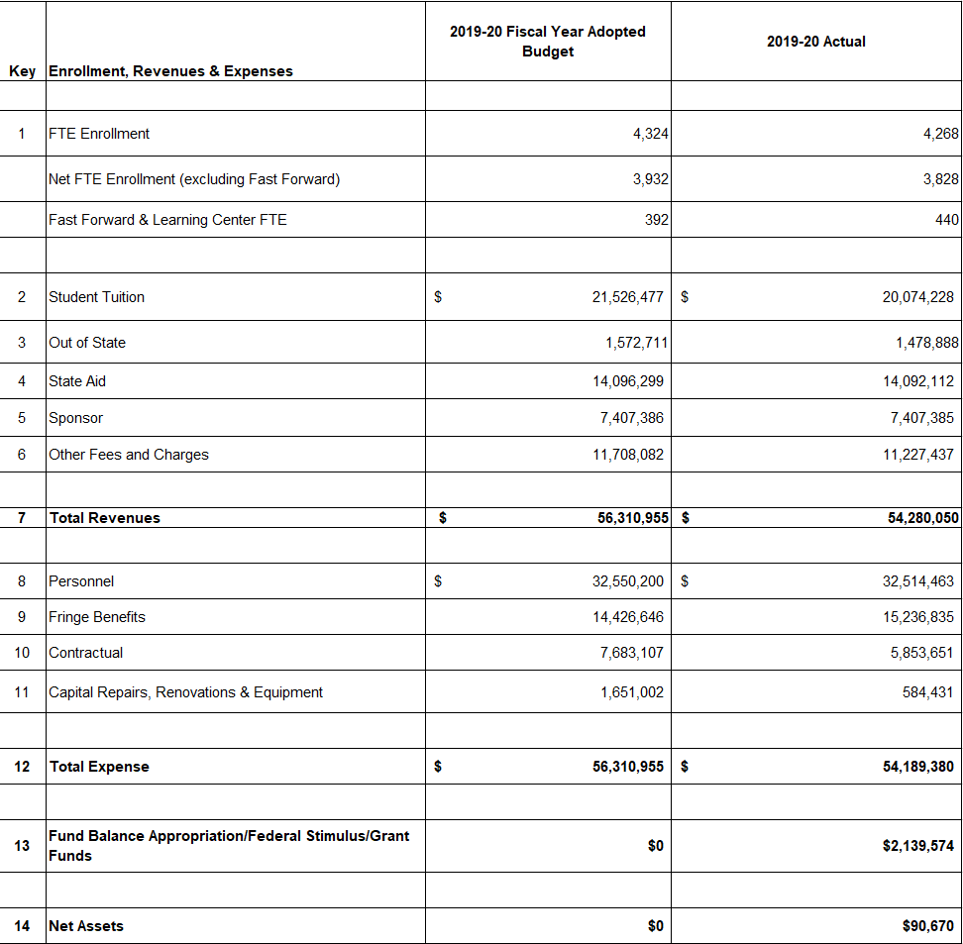
2019-20 Revenue & Expense Summary

Slide 22

Assessment of Budget and Financial Benchmarks*
Benchmark | NY Community College Rank | Metric
Instructional Cost | 4th Highest | 47% of Total
Academic Support Cost | 5th Highest | 10% of Total
Resident Tuition | 17th Lowest | $4,728
Accumulated Fund Balance | 10th Lowest | 10.1% of Total
Library Service Cost | 7th Lowest | 2% of Total
Facilities & Maintenance Cost | 7th Lowest | 11% of Total
Administration Cost | 5th Lowest | 7% of Total
Student Services Cost | 4th Lowest | 7% of Total
Balanced Budget | Highest | 4 Consecutive Years
SUNY Financial Strength Rating | Highest (Green) 9th Highest | 2.0
*Source of Information & Data – SUNY 2018-19 Annual Report of Community Colleges

